Slide 1
MMOG/LE - Tips for Complying with the OEM Submission
Terry Onica, QAD
tjo@qad.com
Director, Automotive

Slide 2
Presentation Agenda
MMOG/LE – Tips for Complying with the OEM Submission
MMOG/LE overview
Answering the MMOG/LE assessment
OEM Assessment Expectations
QAD support
Summary

Slide 3
MMOG/LE Overview
MMOG/LE – Tips for Complying with the OEM Submission

Slide 4
What is MMOG/LE?
MMOG/LE Overview
Materials
Management
Operations
Guideline
Logistic
Evaluation
Notes:
What is MMOG/LE? Well, the letters stand for Materials Management Operations Guideline, Logistic Evaluation. It is a guideline for assessing materials management and logistics operations.

Slide 5
MMOG/LE Authors & QAD Contributions
MMOG/LE Overview
Developed by:
AIAG (North American Industry Association)
Odette (European Industry Association)
Automotive OEMs & Tier 1 Suppliers
Contributions from QAD:
Member & author
Leader of work group efforts
Lead speaker at worldwide events
Trainer provider on behalf of AIAG/Odette
Provider of software that meets requirements
Notes:
The MMOG/LE assessment was originally introduced in 2002 by AIAG (the Automotive Industry Action Group) in North America
<CLICK>
and the Odette organization in Europe <CLICK), together with automotive OEMs like Ford, Chrysler, Volvo Car and Truck, PSA and Renault, and Tier 1 suppliers such as Johnson Controls, Bosch and Gates. QAD joined the MMOG/LE team in 2003 when work began on Version 2 and has been a major contributor ever since.
<CLICK>
QAD has also been a leader of work group efforts, a contributing author,
<CLICK>
and the lead speaker for many industry and OEM MMOG/LE events around the world -- in 19 countries with over 3000 attendees.
<CLICK>
Because of QAD’s deep knowledge and contributions to MMOG/LE, QAD has been chosen as the AIAG and Odette instructor on this topic in many parts of the world.
<CLICK>
Lastly, QAD has software to support key, mandatory MMOG/LE requirements such as ERP, Customer EDI, Supplier EDI or Web, Metrics, Process Maps and Work Instructions.

Slide 6
What is MMOG/LE?
MMOG/LE Overview
Assessment tool to evaluate/select suppliers according to:
Supply chain capabilities
Industry best practices
Provides plant score (e.g., A, B or C)
MMOG/LE = Delivery
ISO/TS-16949 = Quality
Notes:
MMOG/LE is an assessment tool used in the automotive industry by materials management and logistics personnel to evaluate and choose their suppliers. It helps companies assess their supply chain capabilities as compared to industry best practices.
<CLICK>
MMOG/LE because it contains a set of best practices for managing your supply chain, materials and logistics operations, it is also used as a recommended standard throughout the industry.
<CLICK)
In fact, MMOG/LE is often likened to delivery performance, what ISO/TS 16949 is to quality. And, in many cases the two are considered complimentary to each other.

Slide 7
A B C Classification Definition
MMOG/LE Overview
Classification | F3 | F2 | F1 | Score
A Best practice | Compliance to ALL | Non-compliance to < 6 | No limit | > 90%
B Unstable or inconsistent processes | Compliance to ALL | Non-compliance to 6-12 | No limit | 75-89%
C Deficient in key critical areas | Not compliant to ANY | Non-compliance to > 13 | No limit | < 75%
Notes:
Once the assessment is completed, it outputs an overall score of A, B, or C. An A score represents that a supplier demonstrates that that materials management processes are used in the facility are best practice. Although a score of an A has been achieved, an action plan should still be created to eliminate any unmet criteria. To be a level A, a supplier must be compliant to all F3 questions, non-compliant to less than 6 F2 criteria, and have an overall total score of 90% or higher. A B-level shows that an organization is deficient in several areas that may impact its ability to support the needs of the customer. An action plan should be developed and implemented to meet the needs of the business and its customers. To be a level B, a supplier must be compliant in all F3 criteria, non-compliant to anywhere between 6 and 12 F2 criteria, and have an overall score of 75-89%. C is the lowest score a company can be. A C level organization is deficient in several key criteria and could cause serious or prolonged issues to the customer. And action plan should be developed immediately and implemented in a timely manner to ensure that processes are not disrupted internally or with their customers. A supplier is automatically a C-level supplier if they are not compliant to any F3 criteria and/or not compliant to more than 13 F2 criteria, and have a score under 75%.

Slide 8
What is MMOG/LE?
MMOG/LE Overview
Assessment in an excel spreadsheet with:
Six chapters
206 criteria
Answer responses: Yes, No, N/A
 |  |  | 3.1 Product Realization | X
 | 3.1.1 |  | The MP&L function shall formally participate in, and sign off, the Product Realization process.
 | Why? |  | The material organization is involved in each stage (e.g., quoting, engineering) of the Product Realization process to ensure supply chain issues are addressed and parts are available for all phases of production (e.g. prototypes, preproduction, production).
 | Criterion:
1) | F3 | ü | The MP&L function shall participate in the Product Realization process to ensure all material planning and logistics requirements are addressed and all changes which affect the supply process are planned, executed and communicated in a synchronized manner (e.g. bill of material (BOM), routings, effectivity dates, supplier notification, scheduling, shipping). Back-up plans shall be in place to ensure continuity of supply. |  | The engineering change process is outline in WMM- 3111. Engineering Change meetings are held weekly. The materials manager is involved in the meeting. See WMM-3111 for an example of the meeting minutes and invited participants as well as what is included in the organization's engineering change checklist.
Notes:
The self assessment is in the form of an Excel spreadsheet containing six chapters and 206 criteria. OEMs or customers ask sub suppliers to go through all of 206 criteria and indicate if they meet each one. An assessment is typically required initially for all production and after sales or after market suppliers and then annually each year thereafter. OEMs or customers may audit MMOG/LE assessments with their suppliers for new business, on a new product launch or poor delivery performance.

Slide 9
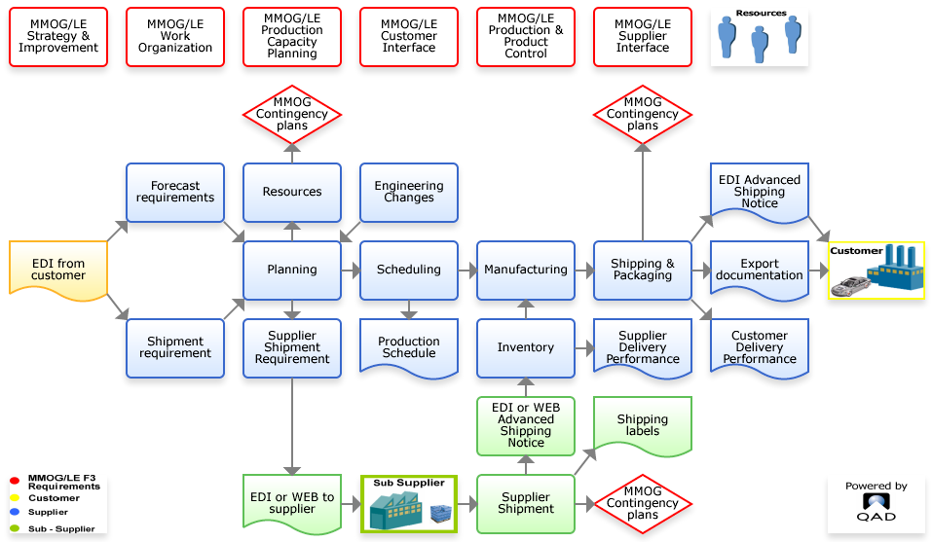
Areas Covered in MMOG/LE
MMOG/LE Overview
Notes:
This process map helps to pictorially show all the key processes that are examined in the MMOG/LE assessment: everything from receiving EDI forecasts and schedules from the customer to shipping the material out the door.
<CLICK>
Across the top in red are the six chapters which are covered in the MMOG/LE assessment. They are Strategy and Improvement, Work Organization, Production and Capacity Planning, Customer Interface and Production and Product Control and Supplier Interface.

Slide 10
MMOG/LE Customer Usage with Suppliers
MMOG/LE Overview
OEMs Using | Tier 1 Using | Tier 1 Using (cont)
Chrysler | Autoliv | SNOP
CNH – Latin America | Benteler | Valeo
Ford | Beru | Wabco
GM | Bosch | ZF
Iveco | Brose
Jaguar/Land Rover | Continental
PSA | Gates
Renault | Johnson Controls | Under Review
Tofas Fiat (Turkey) | Lear | BMW
Volvo Car | MGI Coutier | Daimler
Volvo Truck | Pierburg | Honda NA
VW (US Pilot) | Selzer Automotive | VW
10

Slide 11
OEM Submission Requirements
MMOG/LE Overview
Annual Submissions
Chrysler (Jan-March), Ford and GM (May-July)
Audits
Poor supplier performance
New business
Growing suppliers
New product launch
OEM at risk Suppliers (impacts ability to bid)
Level C
Not submitting MMOG/LE assessment

Slide 12
Answering the Assessment
MMOG/LE – Tips for Complying with the OEM Submission

Slide 13
Surprise Quiz!
Answering the Assessment
How long will it take you to complete the assessment?
How long has your boss given you to do it?
How many departments will need to be involved in completing it?

Slide 14
Let’s Take a Look at a Set of Criteria
Answering the Assessment
Criteria for 3.2.1 Capacity and Resources
1) | F3 | Comparison of resources versus customer requirements shall be reviewed upon receipt of forecast requirements (e.g. 830/DELFOR/planning release), comparing every week of the forecast sent by customers. Capacity planning volumes negotiated with the customer shall also be incorporated in the capacity planning process.
2) | F3 | Resources versus customer requirements shall be reviewed upon receipt of shipping requirements (e.g. 862/DELJIT/ shipping schedules, 866/DELJIT/sequenced shipping schedules), comparing daily ship requirement sent by customers.
3) | F3 | There shall be a process in place to notify customers of any significant resource limitations in meeting the requirements.

Slide 15
How Would You Answer the Criteria?
Answering the Assessment
What departments would you interview?
What questions would you ask to determine compliance?
What objective evidence would you expect to see?

Slide 16
How Would You Answer the Criteria?
Answering the Assessment
What Role or Title would you interview?
Top Management
Supply Chain
Purchasing
Production
Engineering
Human Resources
Quality
IT
Sales
Possibly others, as required

Slide 17
How Would You Answer the Criteria?
Answering the Assessment
What questions would you ask to determine compliance?
How is capacity negotiated with the customer?
How often is capacity reviewed and when?
How are resources versus customer EDI analyzed?
Does analysis include all areas of the business?
Are resources for administrative and containers included?
Does analysis include production, prototype, preproduction and after sales?
Are contingency plans in place for capacity constraints?

Slide 18
How Would You Answer the Criteria?
Answering the Assessment
What objective evidence would you expect to see?
Work instructions including how capacity is negotiated, how customer EDI is integrated
Reports from QAD that shows anything out-of-tolerance
How the customer is alerted of significant resource limitations
Comparative analysis
Release, shipping, financial volumes, industry projections
Meeting minutes including action items
Training
Job descriptions

Slide 19
Quiz – Have Your Answers Changed Yet?
Answering the Assessment
How long will it take you to complete the assessment?
How long has your boss given you to do it?
How many departments will need to be involved in completing it?

Slide 20
OEM Assessment Expectations & Common Supplier Mistakes
MMOG/LE – Tips for Complying with the OEM Submission

Slide 21
Extensive Use of Spreadsheets = Level C
MMOG/LE: Tips for Satisfying the OEM Requirement
Planning
Scheduling
Sub Suppliers
A

Slide 22
Who is Leading the Assessment?
MMOG/LE – Tips for Complying with the OEM Submission
ISO/TS 16949, is a technical specification for quality management
MMOG/LE is similar, but focuses on supply chain processes.
MMOG/LE has adopted the same process approach as ISO/TS 16949
Example: Scrap process
Quality
Notes:
Most automotive suppliers are familiar with ISO/TS 16949. ISO, which stands for the International Organization for Standardization, is the world's largest developer and publisher of international standards.
ISO/TS 16949, which is an ISO technical specification for automotive production and service organizations, is aimed at the development of a quality management system that provides for continual improvement.
MMOG/LE mirrors this goal of ISO/TS 16949, but with a specific emphasis on supply chain operations. MMOG/LE has adopted the same process approach as ISO/TS 16949 for developing, implementing, and improving the effectiveness of the supply chain management process in order to enhance customer satisfaction by meeting customer requirements. In essence, MMOG/LE is to supply chain management what ISO/TS 16949 is to quality management.
MMOG/LE is to supply chain and delivery what ISO/TS 16949 is to quality
Scrap example for MMOG/LE and Quality to stress they are complementary not the same. Add to your Work Instructions those things need to run the materials side of the business.
Both, TS 16949 and MMOG/LE emphasize defect prevention and the reduction of variation and waste in the supply chain, while ensuring customer satisfaction.

Slide 23
Is MMOG/LE Being Driven by Management?
MMOG/LE – Tips for Complying with the OEM Submission
Driven by Operations and Executive Management teams, championed by Materials Management
The Corporate Delivery Champion (CDC) is responsible for improving and standardizing delivery performance across the enterprise
Understand the customers’ supply chain and delivery requirements as outlined in the:
Global Terms and Conditions
Supplier Manuals and Reference Guides
Supplier Web Sites
MMOG/LE

Slide 24
What is a CDC?
MMOG/LE – Tips for Complying with the OEM Submission
Required/requested for suppliers with multiple sites by Ford, Chrysler and GM
Serves as the corporate supply chain contact for all manufacturing and ship sites for delivery performance
Standardizes and improves supply chain processes and procedures
Oversees MMOG/LE compliance
Ensures corrective actions are resolved in a timely manner
Documents and shares lessons learned

Slide 25
Is the Right Person Answering the Question?
MMOG/LE – Tips for Complying with the OEM Submission
Process owners, including management
All facilities and shifts
Areas with vital involvement in the assessment process include:
Top management
Supply chain
Corporate delivery champion
Purchasing
Production
Engineering
Program manager
Human resources
Quality
IT
Logistics
Sales

Slide 26
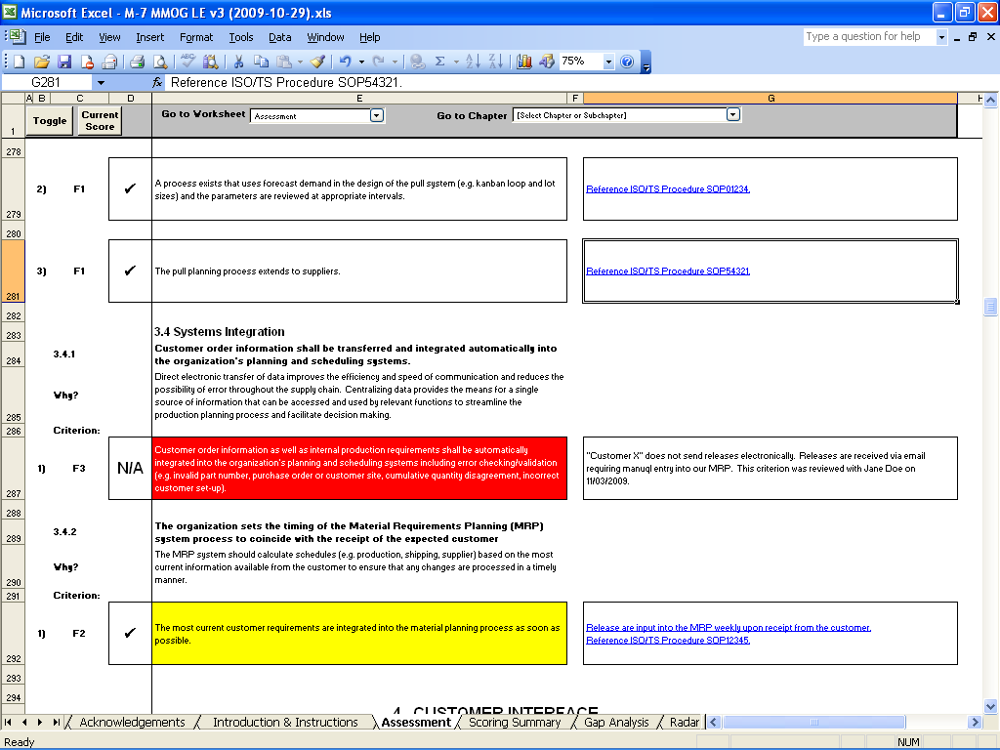
Are You Thoroughly Documenting Responses?
MMOG/LE – Tips for Complying with the OEM Submission
Comments box
best practices
Evidence
Comments
Work instructions
Non applicable
Annual review
Customer specifics
Notes:
As suppliers go through the self assessment, they have three options for answers:
A check mark, which means the organization is 100% compliant with the criteria. Fore example, one of the MMOG/LE criteria ask if EDI releases are automatically integrated into the planning system. If an organization has an ERP system that is capable of doing this, but they don’t use it but instead manually process customer release data using spreadsheets - they should mark the criteria as non compliant by leaving the box blank. Having the capability, but not using it, means that an organization is not complaint.
The next option of answering is Non Applicable. Non Applicable means that the criteria should not be considered for the assessment because it does not apply to the organization. This typically happens when the customer requests a different procedure or the criteria simply does not apply to the organizations business.
You can see that this organization has marked some of the criteria as complaint and non applicable. One of the newer features of MMOG/LE is to allow the supplier to make comments for each criteria.
Keeping good comments is critical -- especially, as people come and go from an organization. With good comments, each year, the internal MMOG/LE assessor can see what the prior year’s evidence on how the criteria was answered. So that on each subsequent annual update of MMOG/LE, they can simply review and update the prior year’s comments and update as necessary
One of the most important usages of the comments box is to document evidence or proof that an organizations business meets the criteria. Should a customer do an audit or a review of the supplier’s assessment, the evidence can be readily located. Not being able to find evidence readily for an auditor could be proof that proper controls are not in place in the organizations processes. This could be a reason to fail a supplier on an audit or to go more deeper in the audit than originally planned. Submitting a MMOG/LE assessment with very few or no comments can trigger suspicion by a customer of the assessment especially if the assessment score is a Level A.
QAD has put together an answer sheet for our customers to help document where our products can be of assistance to support MMOG/LE. You will learn more about this later in this module.

Slide 27
If you were the OEM, what would you think of the supplier response to 3.2.1 Capacity Planning?
F3 | P | Comparison of resources versus customer requirements shall be reviewed upon receipt of forecast requirements (e.g. 830/DELFOR/planning release), comparing every week of the forecast sent by customers. Capacity planning volumes negotiated with the customer shall also be incorporated in the capacity planning process. |  | Capacity planning worksheet (Weekly and Quarterly)
F3 | P | Resources versus customer requirements shall be reviewed upon receipt of shipping requirements (e.g. 862/DELJIT/shipping schedules, 866/DELJIT/sequenced shipping schedules), comparing daily ship requirement sent by customers. |  | JIT and daily meeting
F1 | P | Resources for administrative (e.g. receiving, planning, and dispatch) and physical (e.g. loading, unloading of trucks) operations within the MP&L function, including time and cost, are reviewed and incorporated in the capacity planning process. |  | Informal system

Slide 28
When Quality Answers…
If you were the OEM, what would you think of the supplier response to 1.2.1 MP&L Objectives ?
F2 |  | Objectives are documented, specific, measurable, achievable, realistic, timely and consistent with the organization's MP&L strategy. |  | Quality Objectives added into Managament Review. Records available on site.
F2 |  | Objectives are accepted by all relevant functions and are clearly communicated throughout all levels of the organization. |  | Quality Objectives added into Managament Review. Records available on site.
F2 |  | Objectives are reviewed with top management at planned intervals. |  | Management Review daily, members Quality Plan & Staff reviewing trends and performances for the scrap control, external PPMs, Internal PPMs, inventory and effectivity. Objectives added into Management Review ISO/TS . Records available on site.

Slide 29
Good Assessment Comments – 4.3.2 Shipping
1) | P | The shipping label shall be reconciled against the customer ship requirements. The data content of the shipping labels shall be verified at the last possible point in the shipping process, such as RFID or scanning, to ensure consistency between container content, labels, and documentation. |  | Work instruction for ASN process is WI-ASN-0030-EM -FORD. Ford Ranger wax frames will not have a shipping label they will be stenciled due to Ford spec and nature of waxed product. Econoline ecoated frames are labeled and scanned coming out of e-coat prior to loading for shipment.
2) | P | The organization shall ensure that the data content of all ASNs is complete, accurate and processed in accordance with customer requirements. When master labels are used, individual container labels shall be reconciled to master labels. |  | Shipper creation 50.6.4 requires that customer-specific fields are populated with appropriate data to complete the shipper. ASN export 50.6.22 also requires customer specific data (according to Ford EDI Implementation Guideline) and uses data fields from shipper creation to generate ASN data. Master labels not used. eDDL & CMMS instructions for shipment follow-up are located in MPL in a box. Process is documented in WI-ASN-003-EM-Ford for creating an ASN.
3) | P | All shipments, including documentation and labeling, shall be prepared to customer, industry, and government/international standards and requirements (e.g. customs handling, C-TPAT, PIP, AEO) including carrier routings. |  | Only documentation required is the packing slip (50.6.4) and the shipper (50.6.8); ASN export screen is (50.6.22). Labeling is covered in MMOG/LE 4.3.2.1. Ford labeling specs are listed in MP&L In A Box as indicated in Work instruction for ASN process is WI-ASN-0030-EM -FORD
4) | P | The shipment process shall ensure that each ASN is transmitted at the time of conveyance departure. |  | ASN is transmitted at the time of truck departure. The 997 document is reviewed upon receipt and transmission errors are reported to supervisor/manager. Corrections are made and re-sent ASAP, no later than 30 minutes. eDDL AJAA is monitored after each shipment to ensure shipment/CUM accuracy. Work instruction for ASN process is WI-ASN-0030-EM –FORD.

Slide 30
Have You Documented Customer Specifics?
MMOG/LE – Tips for Complying with the OEM Submission
Where will you find customer specifics?
Customer training
Global terms and conditions
Materials planning and logistics agreements
Supplier manuals
Customer web sites and applications
EDI portals
Delivery rating
Capacity
Packaging and labeling
Container management

Slide 31
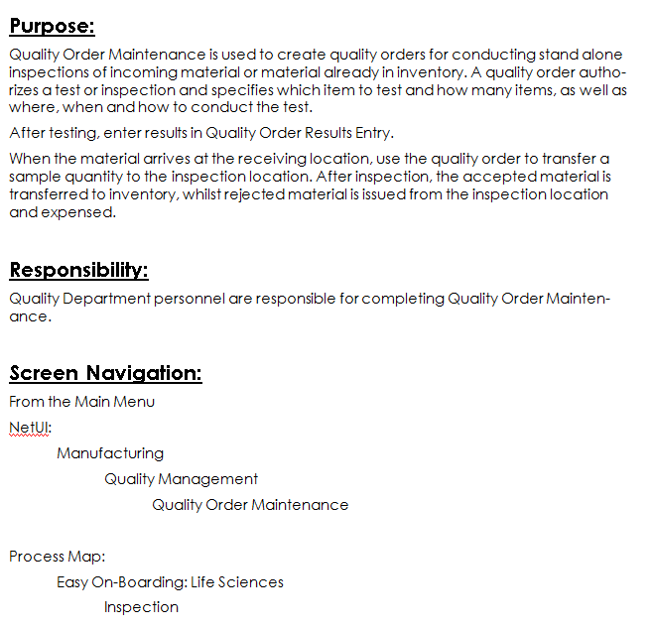
Are Your Work Instructions Detailed Enough?
MMOG/LE – Tips for Complying with the OEM Submission
Used for training and back-ups
Instructions should Include:
Step by step instructions
Person(s) responsible
Customer specifics
Customer references
Metrics
Error handling
Contingencies
Document version control
Last date tested
Explanation of any acronyms
Obtaining user logins
Notes:
One of the real critical pieces to completing the MMOG/LE assessment is making sure that an organization has good work instructions. Here is where organizations typically fall short of OEM expectations. Work instructions typically are not very robust. In order to pass an OEM audit they should include the elements we see here.
Because work instructions will be used for training, relief and back ups, they should be detailed and contain step by step instructions. The other critical element of a work instruction is that it includes and customer specific requirements and customer references. For example, if the customer requests specific information to be included on an EDI ASN, the work instruction should note this. Or, if the customer expects an organization to view their portal to obtain daily bulletins, the work instruction should include the customer portal and directions on how to obtain the daily bulletin.
Also important in a work instruction are ways to handle any errors that might arise in the process. For example, what to do if an ASN is rejected by the customer’s system. Additionally, any contingency or emergency procedures that need to be invoked if the process or system fails. For example, what should an employee do if the EDI or ERP system goes down and they are unable to send ASN data.
Work instructions are important because they are evidence to both management and customers that the organization can demonstrate ongoing control of operational processes.

Slide 32
Answers to the Quiz
MMOG/LE – Tips for Complying with the OEM Submission
How long will it take you to complete the assessment?
It can take up to six weeks to gather evidence
It can take up to four months to close gaps
How long has your boss given you to do it?
See answer to A!
How many departments will need to be involved in completing it?
Just about every department!

Slide 33
QAD Support
MMOG/LE – Tips for Complying with the OEM Submission

Slide 34
107 Automotive Process Maps
QAD Support
Notes:
QAD’s automotive solution is build around a set of process maps addressing all 206 MMOG/LE compliance points.

Slide 35
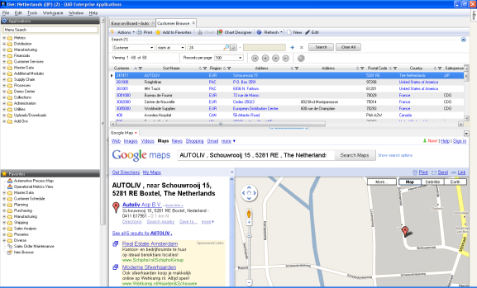
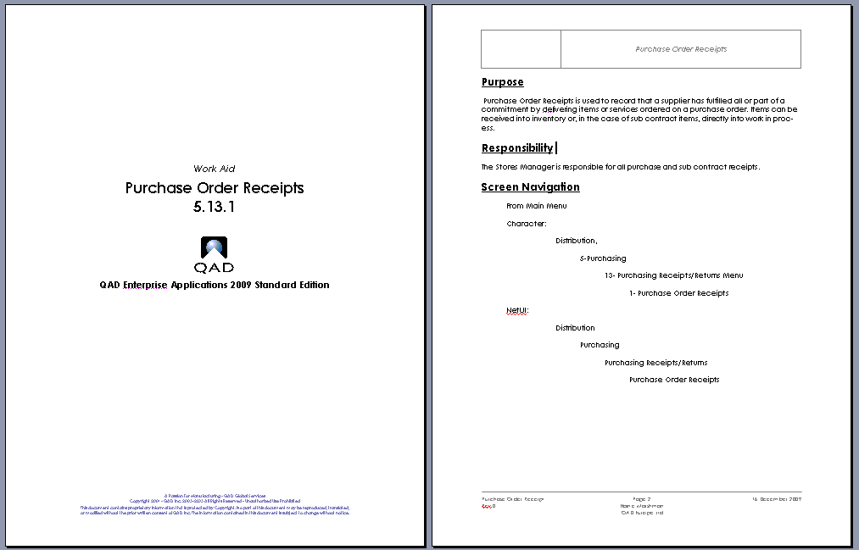
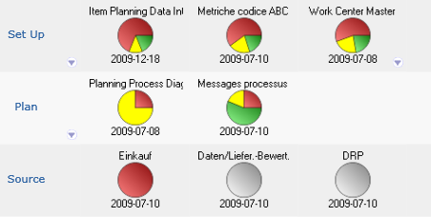
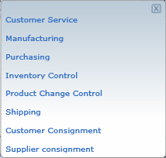
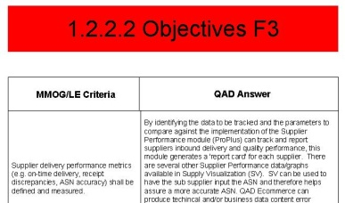
QAD MMOG/LE Process Map Features
QAD Support
System Access
Tool Tips
Work Instructions
Operational Metrics
Training Material
Compliance Check Points
Notes:
Break into Multiple slides to show each one like last time?
Access to menu options and URLs – system access including live links to other applications or documents at any step in the process
Tool Tips – aide memoir for users
Work Instructions – detailed instructions on screen use
Operational Metrics to monitor data integrity and performance
Compliance Check Points – best practice by industry
And Built in Training

Slide 36
600+ QAD Work Instructions
QAD Support
Notes:
All work instructions follow the same format. QAD has over 600 work instructions available. QAD’s work instructions include:
Purpose explains the purpose of the screen.
Responsibility denotes which group are responsible for completing this screen.
Screen Navigation shows the use how to navigate to this menu option from the main menu.

Slide 37
115 Integrated Training Courses
QAD Support

Slide 38
QAD MMOG/LE Answer Sheet
QAD Support
MMOG/LE
Criteria
QAD
Answer
Probing/
Evidence
Questions
Location on Process Map
Notes:
38
QAD has also put together what we call the “QAD MMOG/LE Answer Sheet”. A team of us did at QAD took each of the 206 criteria and answered how the QAD product suite might help the organization be compliant to each answer. The QAD answers can be found on the gap analysis tab of our answer sheet.
Here we describe in detail the:
QAD product solution to answer the criteria, sometimes down to the menu item.
Next, we note any critical OEM specifics or audit requirement expectations that we are aware of.
In the next column, we have the probing questions that QAD consultant would ask when determining if the organization meets the criteria.
The last column is the process map or maps that are impacted by the criteria.
I am the owner of the QAD MMOG/LE Answer Sheet. If you, your customer or prospect would like a copy of it, you can contact me to get a copy of it.

Slide 39
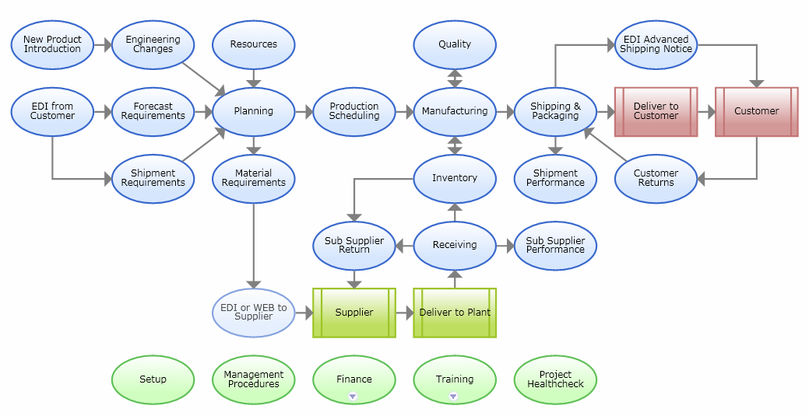
MMOG/LE Q-Scan
QAD Support
Review critical questions & top criteria
Review processes, procedures & work instructions
Present findings to management
Notes:
Besides the training, there is also a QAD offering called the “MMOG/LE Review” or “Q-Scan.” It is a two-day, on-site review of your MMOG/LE preparation.
<CLICK>
We examine 35 critical questions and the top 20 critical criteria that impact all of the processes that you see circled here in red,
<CLICK>
and we review your processes and procedures to make sure that your documentation and evidence is in good order.
<CLICK>
At the end of the two days, we present the findings to your management team.

Slide 40
QAD MMOG/LE Review Outcomes
QAD MMOG/LE Support
Validation of your assessment score (e.g., A, B, C)
Proper usage of ERP (spreadsheets are eliminated)
Using spreadsheets = Level C
The right people are answering the assessment
Customer specifics are being addressed
Criteria “Comments Boxes” are properly documented
Work Instructions are to the right level of detail
Management understands the score and any gaps

Slide 41
Additional Support
QAD Support
White Paper
Solutions Brochure
www.qad.com/mmogle
AIAG/Odette MMOG/LE Level 1 Training
Register at www.aiag.org or www.odette.org
Corporate Delivery Champion Meeting
Operational management
Ford, Chrysler and GM
November 14, 2012 in Detroit area

Slide 42
Thank you!

