Slide 1
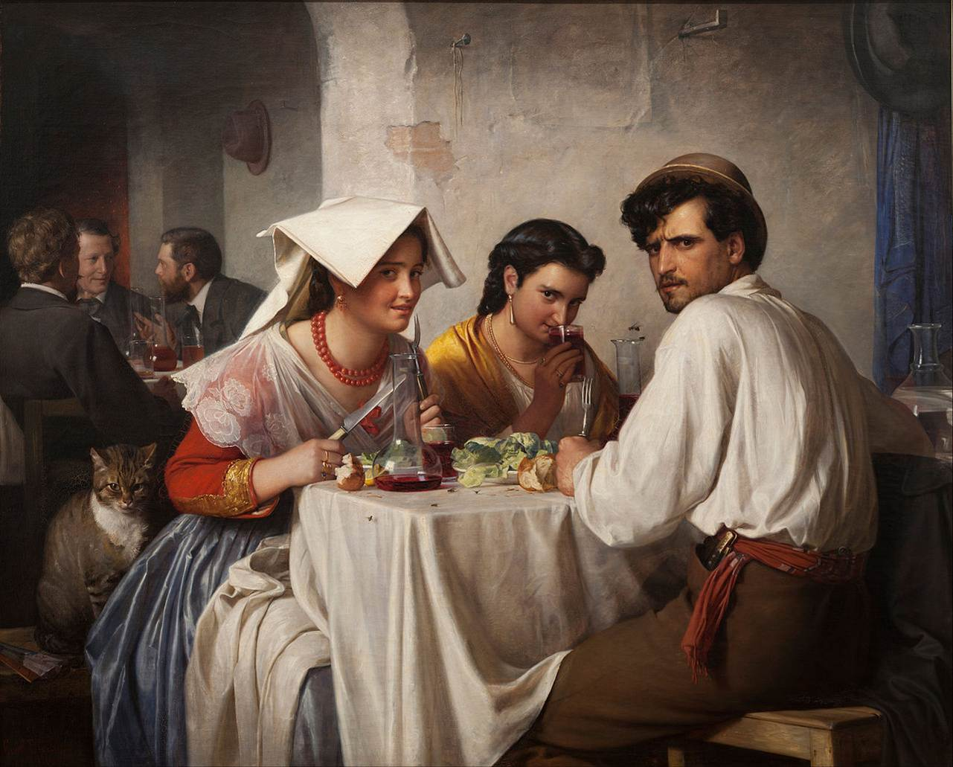

In a Roman Osteria
Notes:
In a Roman Osteria

Slide 2
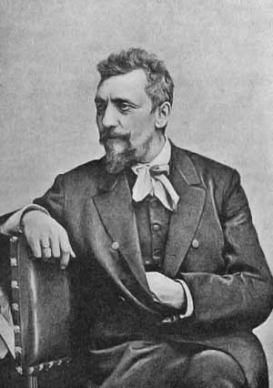
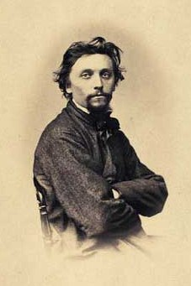
Carl Heinrich Bloch
(1834-1890)
Danish painter

Slide 3
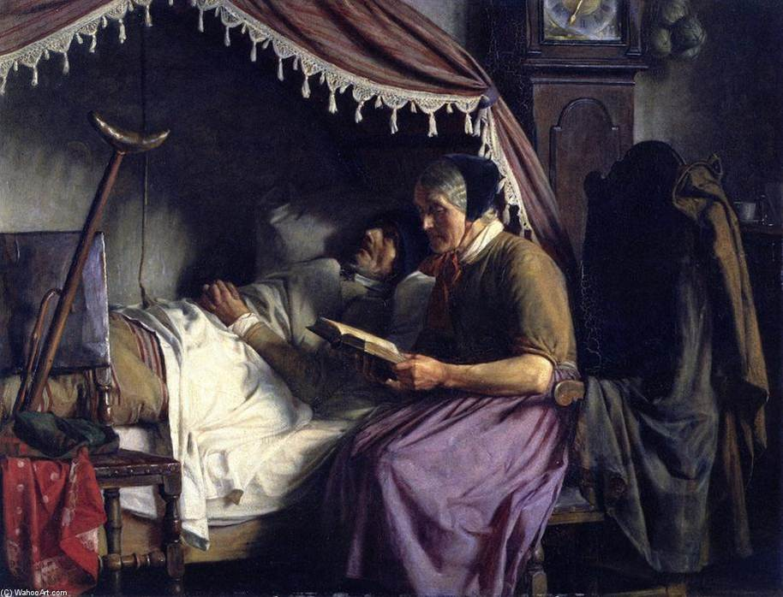
Old People
Notes:
Old People

Slide 4
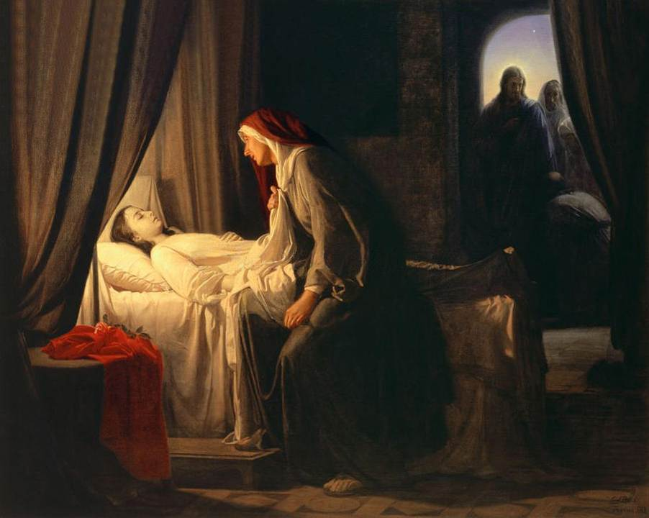
Daughter of Jairus
Notes:
Daughter of Jairus

Slide 5
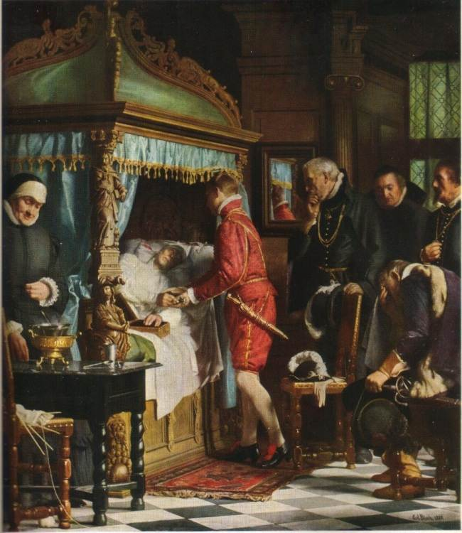

Slide 6
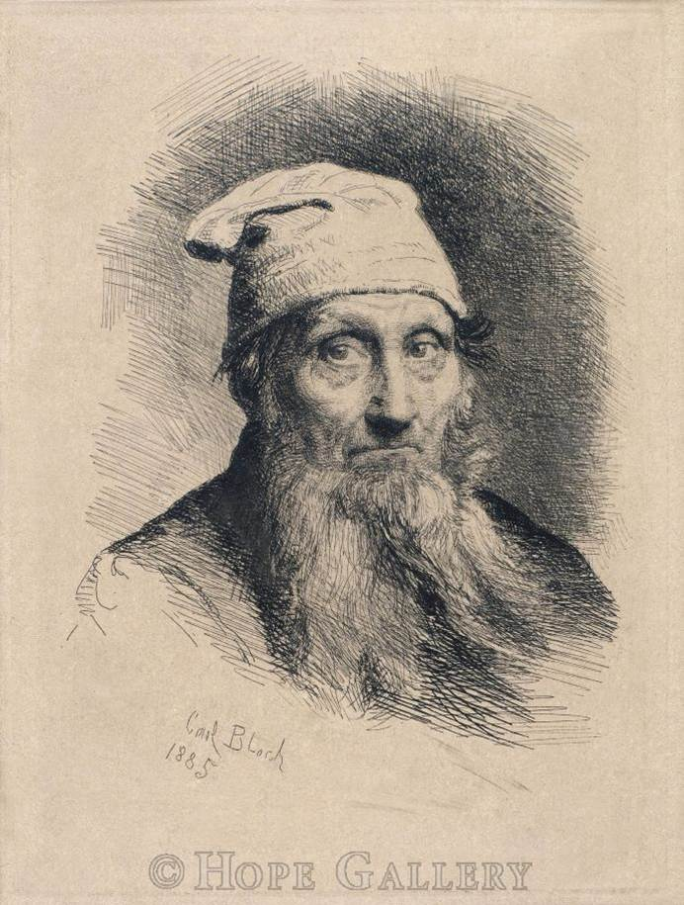
A Fisherman from Naples
Notes:
A Fisherman from Naples

Slide 7
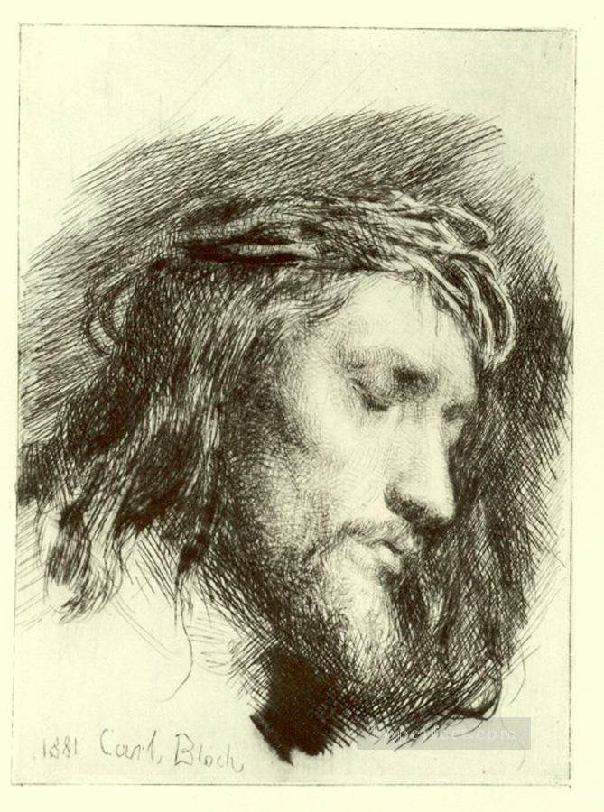
Portrait of Christ
Notes:
Portrait of Christ

Slide 8
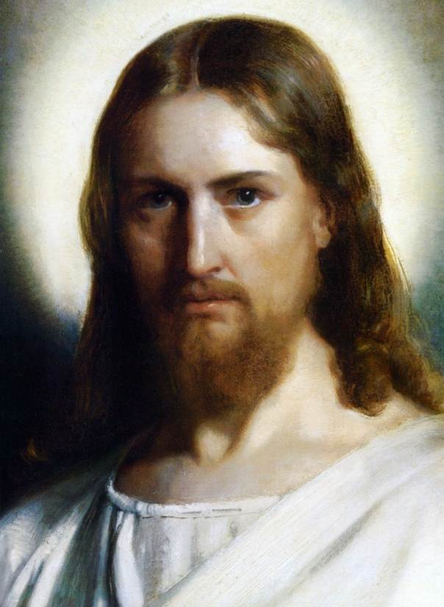
The Face of Jesus
Notes:
The Face of Jesus

Slide 9
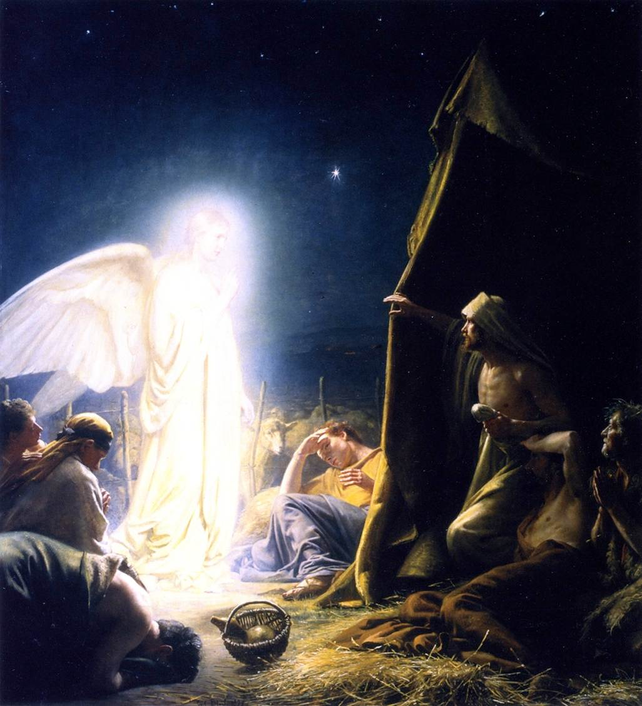
The Shepherds &
the Angel
Notes:
The Shepherds & the Angel

Slide 10
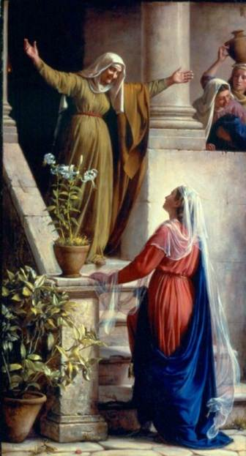
Mary & Elizabeth
Notes:
Mary & Elizabeth

Slide 11
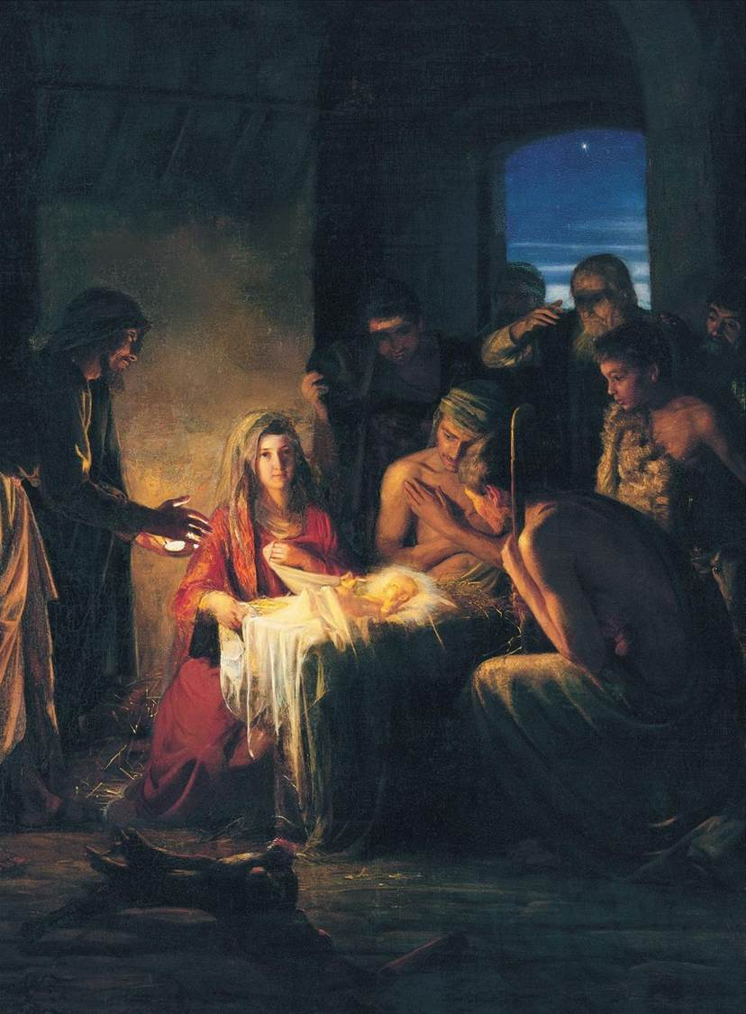
Birth of Jesus
Notes:
Birth of Jesus

Slide 12
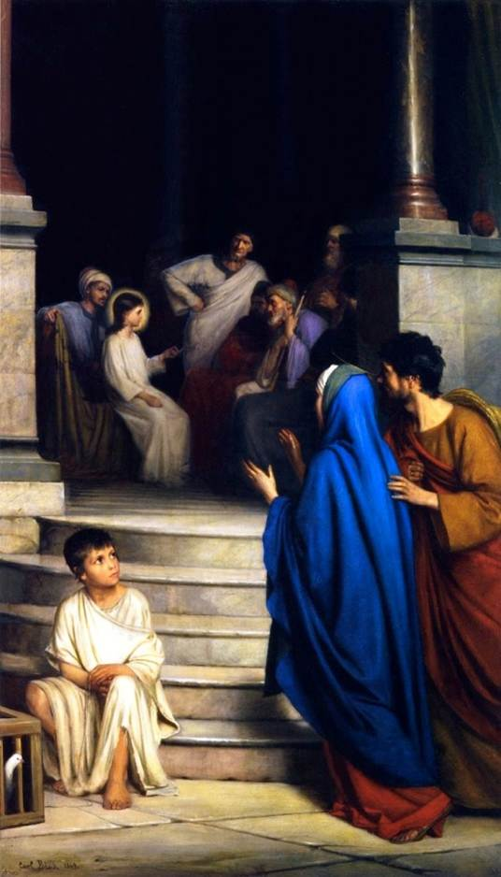
12 Year Old Jesus in the Temple
Notes:
12 Year Old Jesus in the Temple

Slide 13
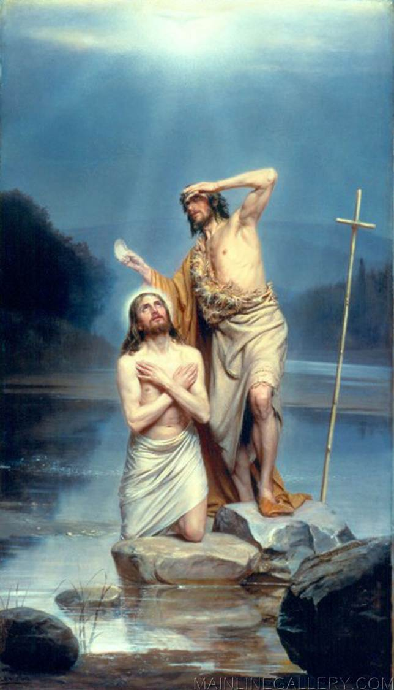
Christ Baptism
Notes:
Christ Baptism

Slide 14
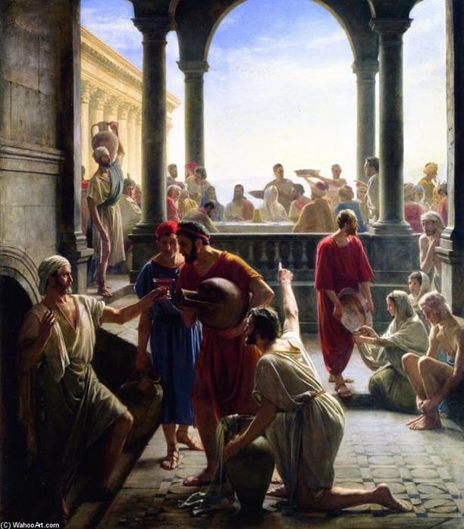
The Wedding at Cana
Notes:
The Wedding at Cana

Slide 15
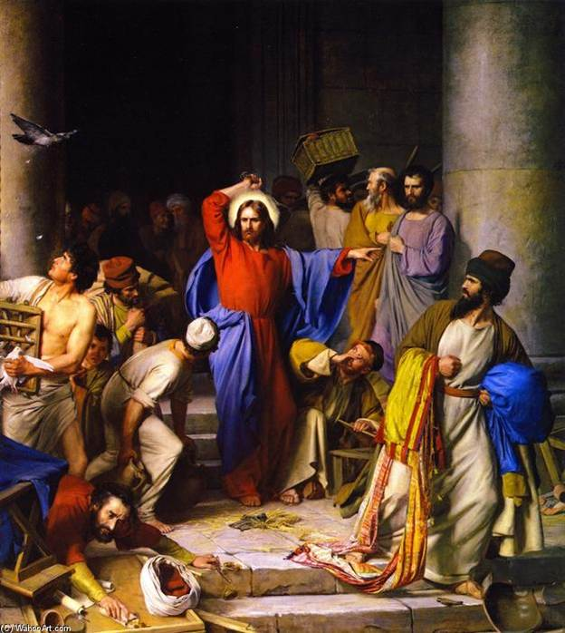
Cleansing of the Temple
Notes:
Cleansing of the Temple

Slide 16
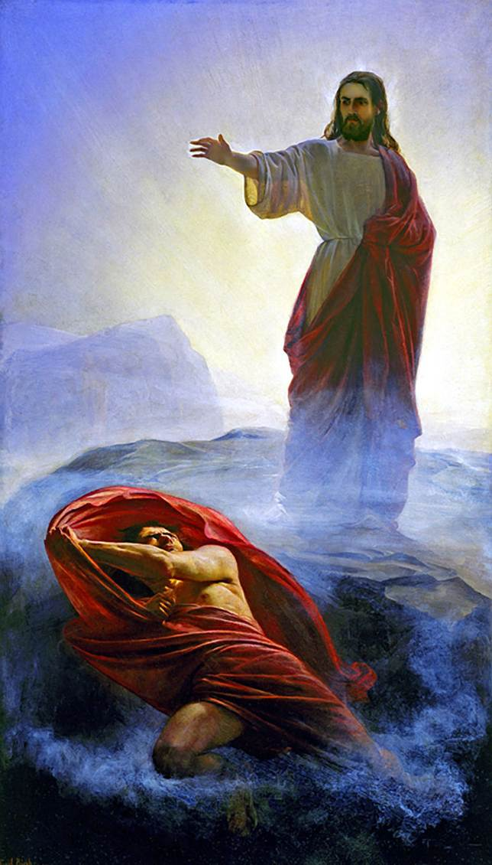
Jesus Tempted
Notes:
Jesus Tempted

Slide 17
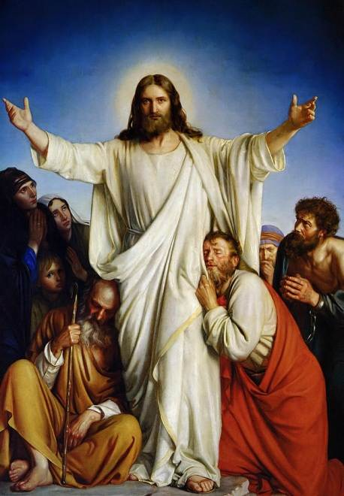
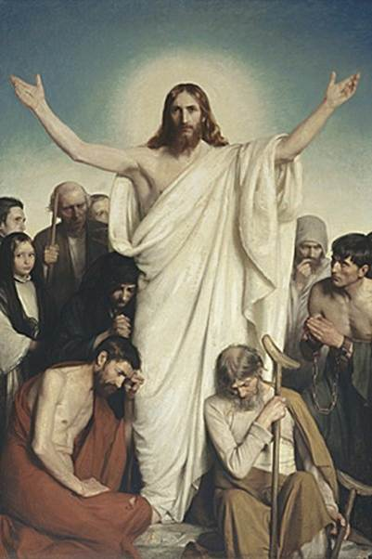
Christus Colsulator
Notes:
Christus Colsulator

Slide 18
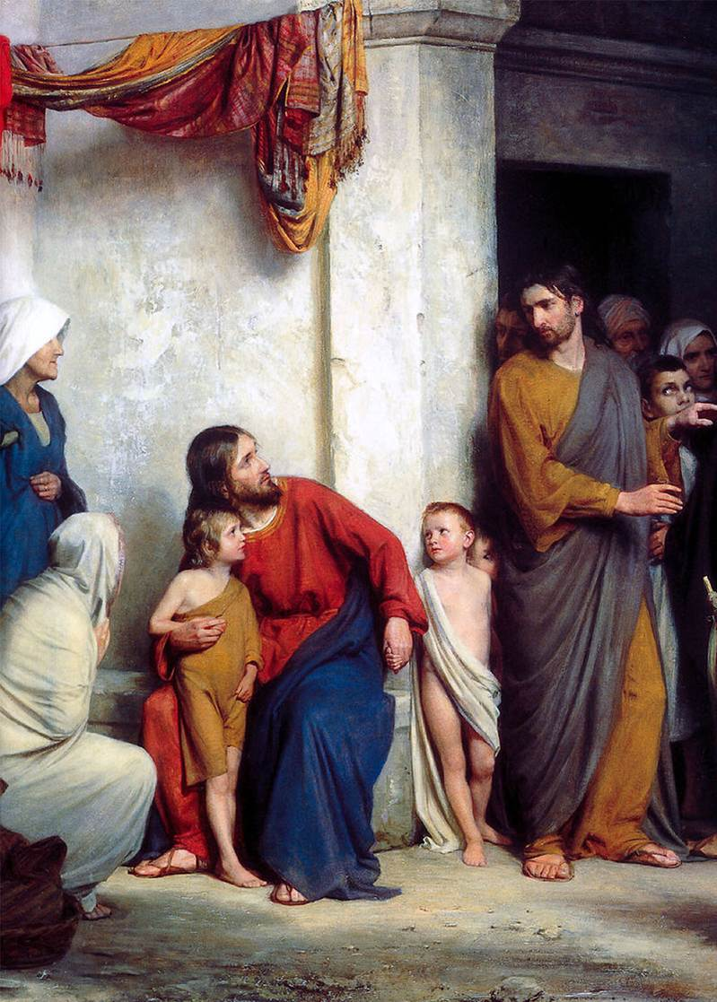
Suffer the Children
Notes:
Suffer the Children

Slide 19
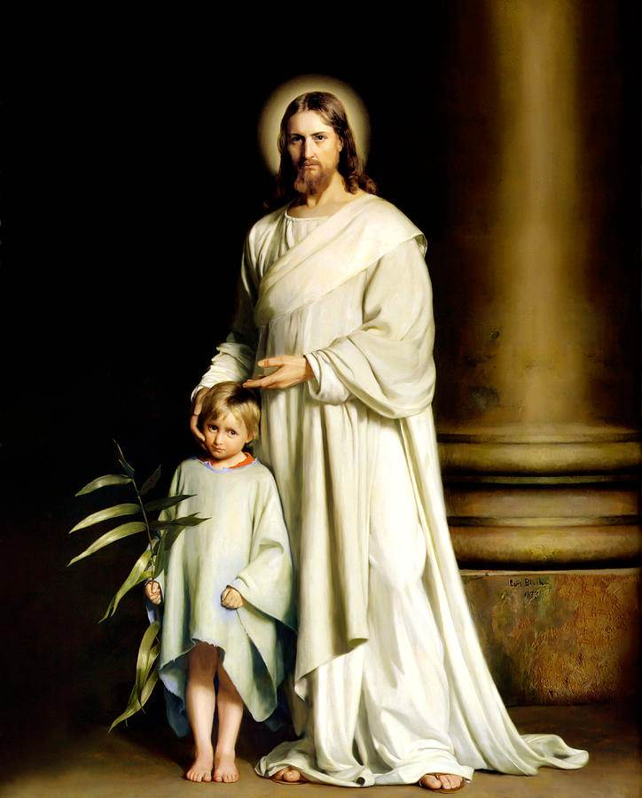
Christ & the Young Child
Notes:
Christ & the Young Child

Slide 20
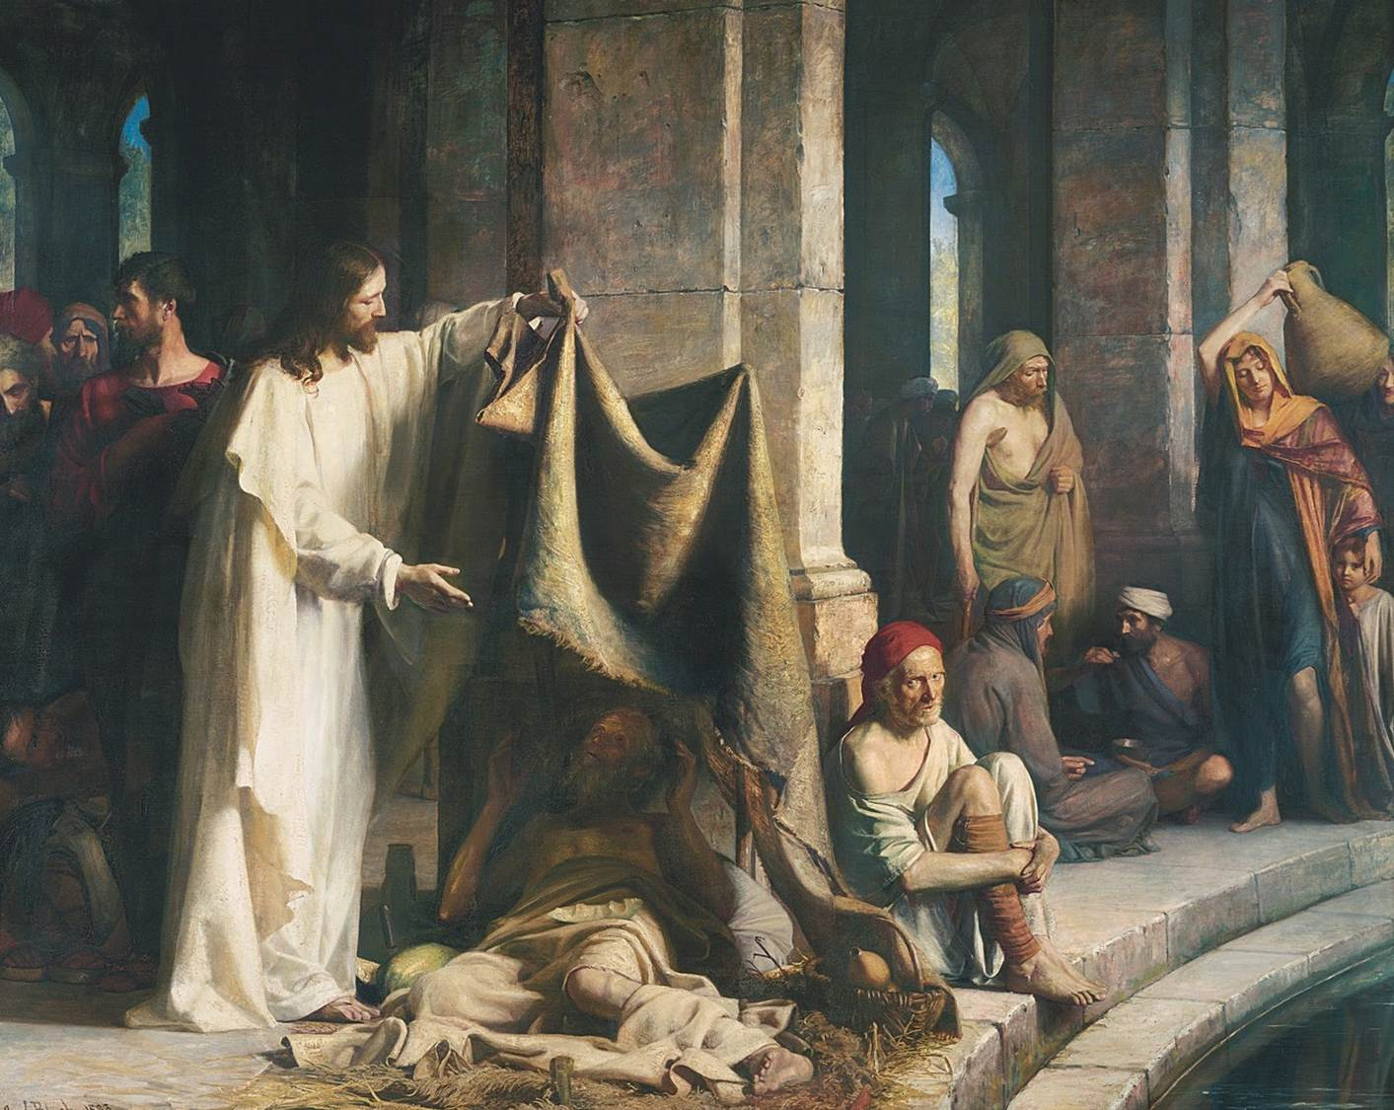
Christ healing the Sick
Notes:
Christ healing the Sick

Slide 21
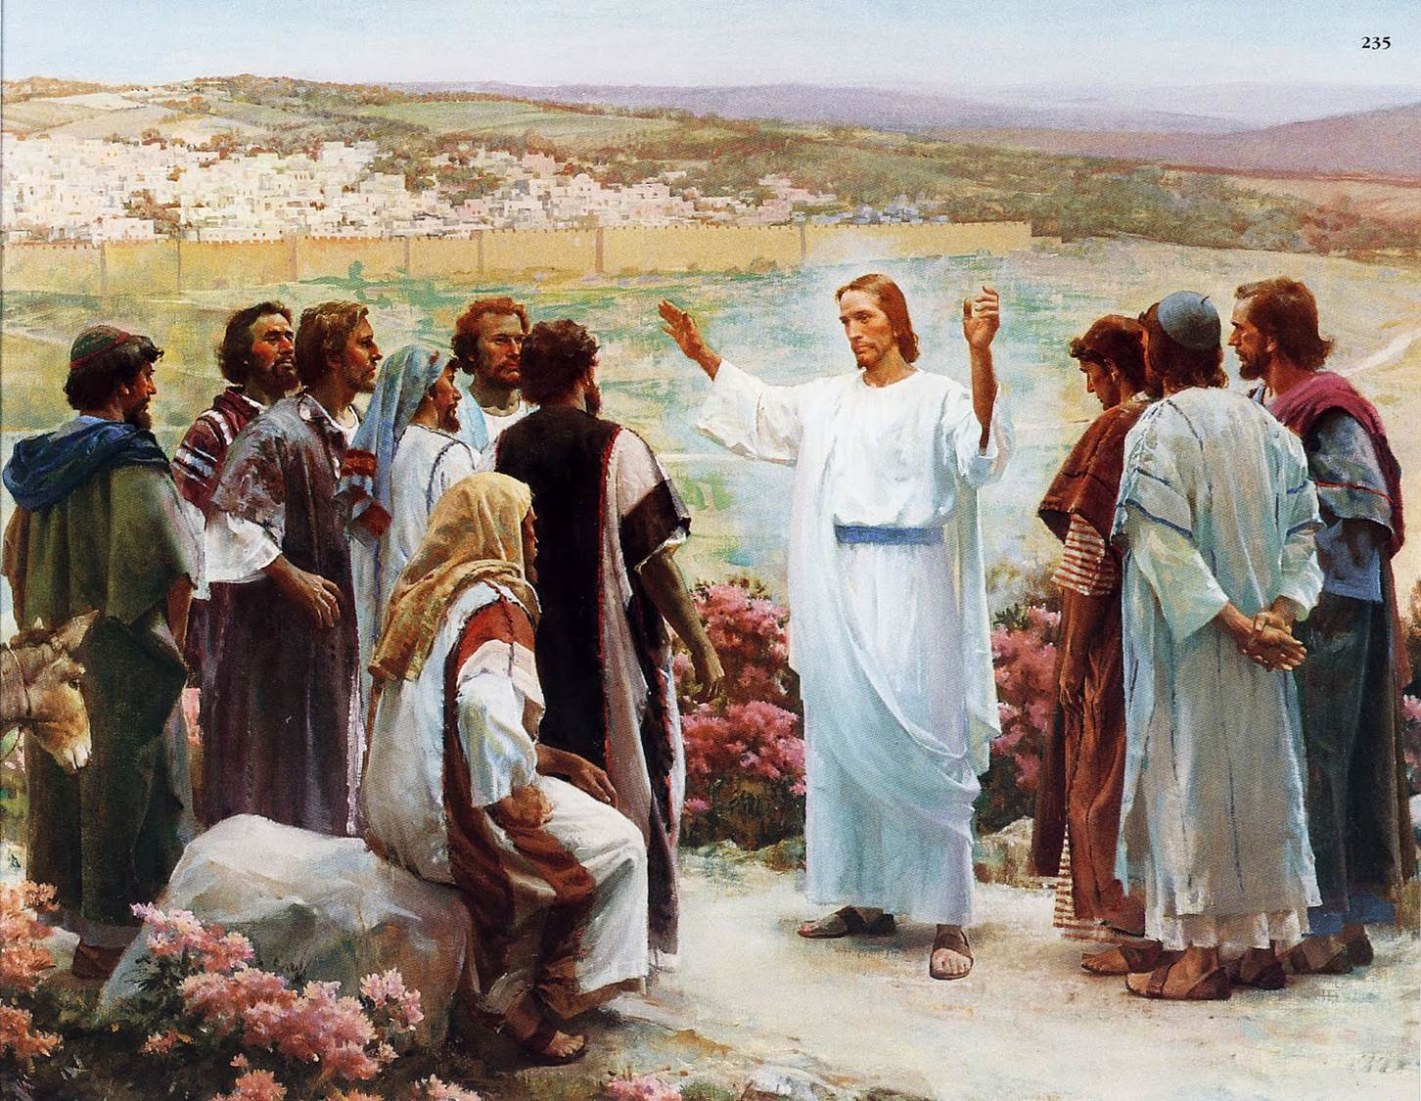
Christ Healing the Sick
Notes:
Christ Healing the Sick

Slide 22
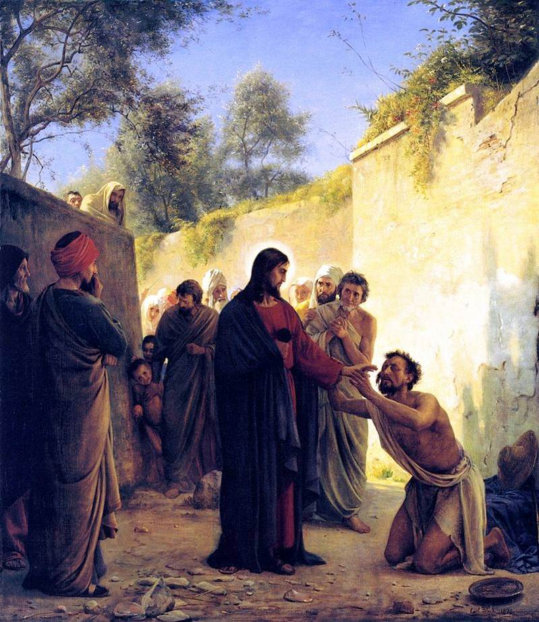
Healing of the Blind Man
Notes:
Healing of the Blind Man

Slide 23
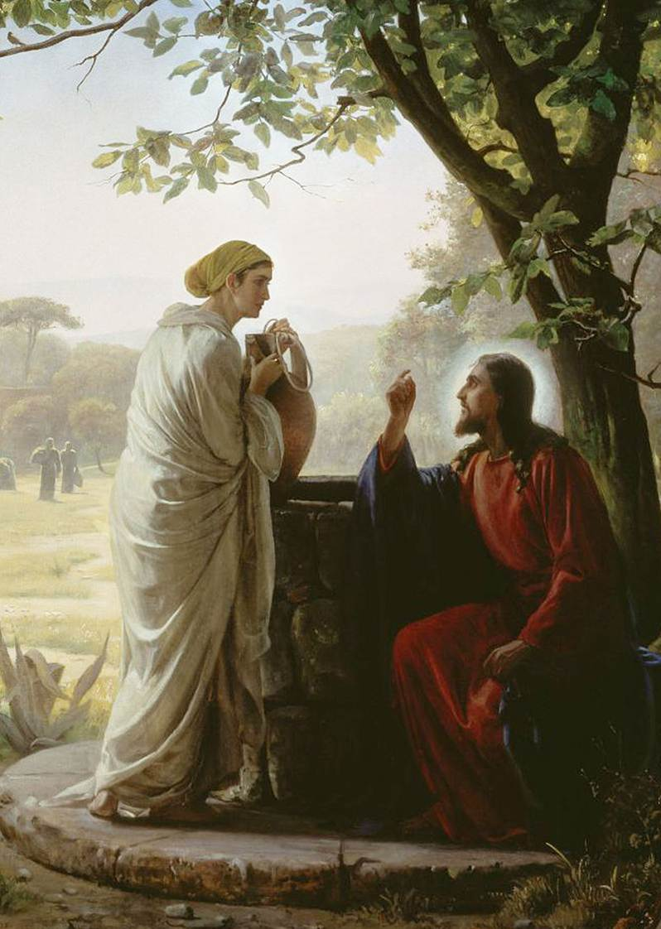
Woman at the Well
Notes:
Woman at the Well

Slide 24
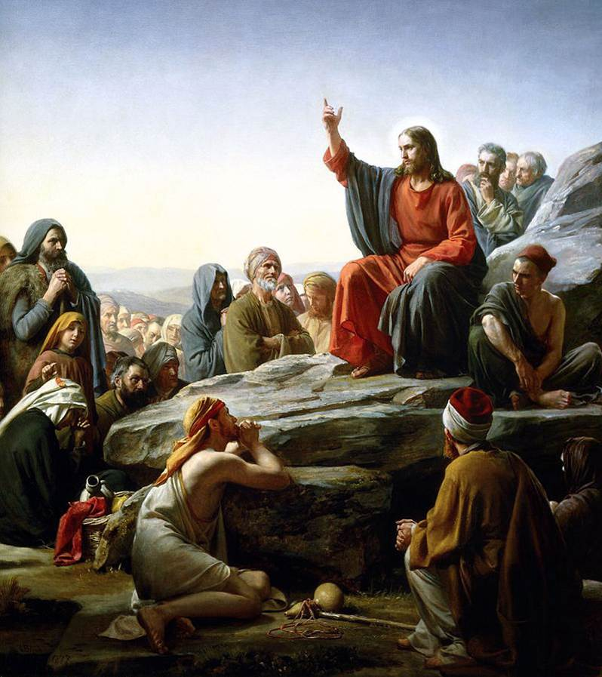
The Sermon on the Mount
Notes:
The Sermon on the Mount

Slide 25
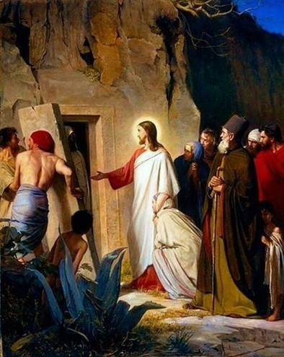
Rasing of Lazarus
Notes:
Rasing of Lazarus

Slide 26
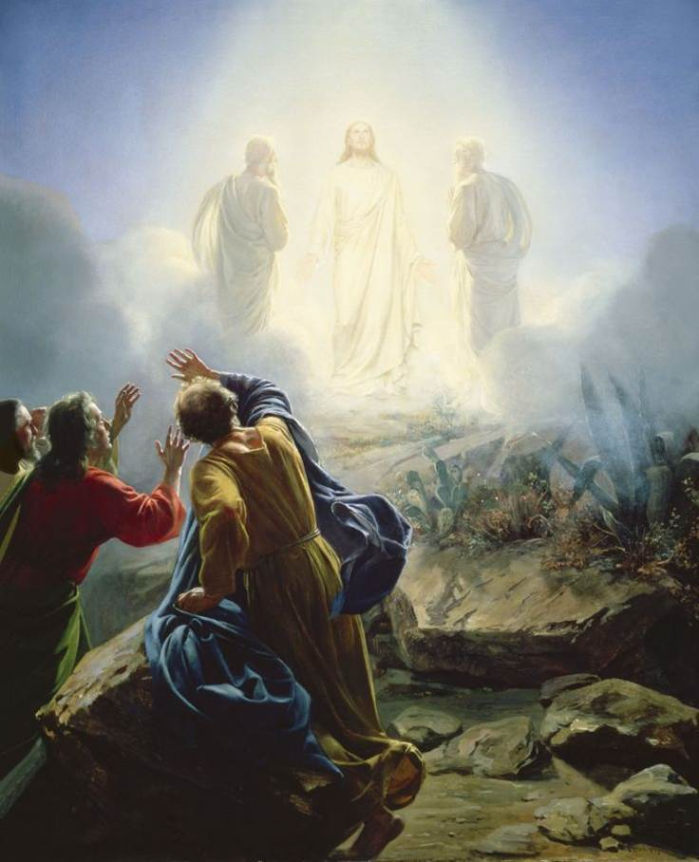
Transfiguration
Notes:
Transfiguration

Slide 27
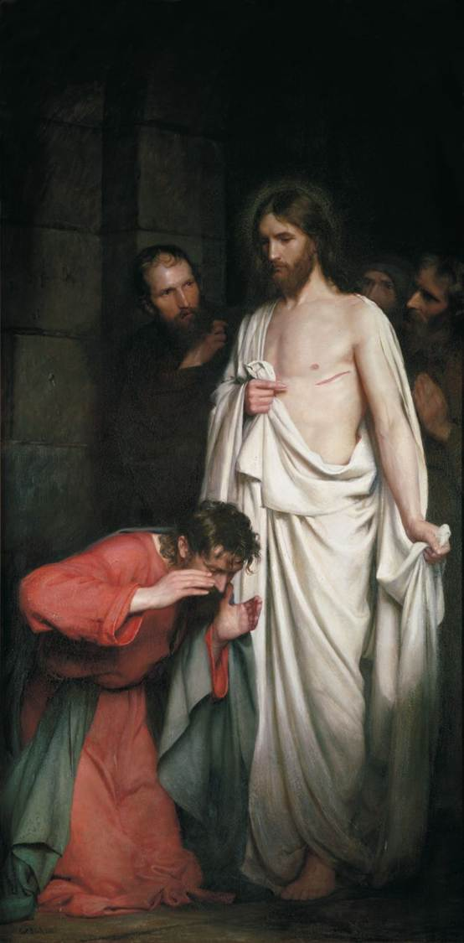
The Doubtful Thomas
Notes:
The Doubtful Thomas

Slide 28
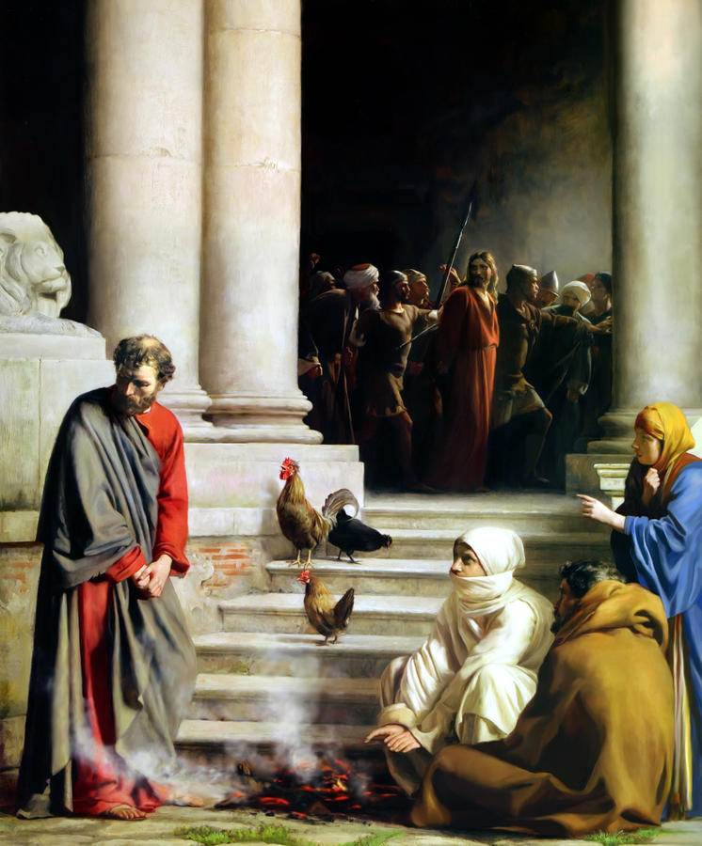
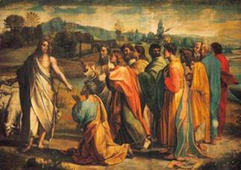
Peter’s Denial
Peter’s Remorse

Slide 29
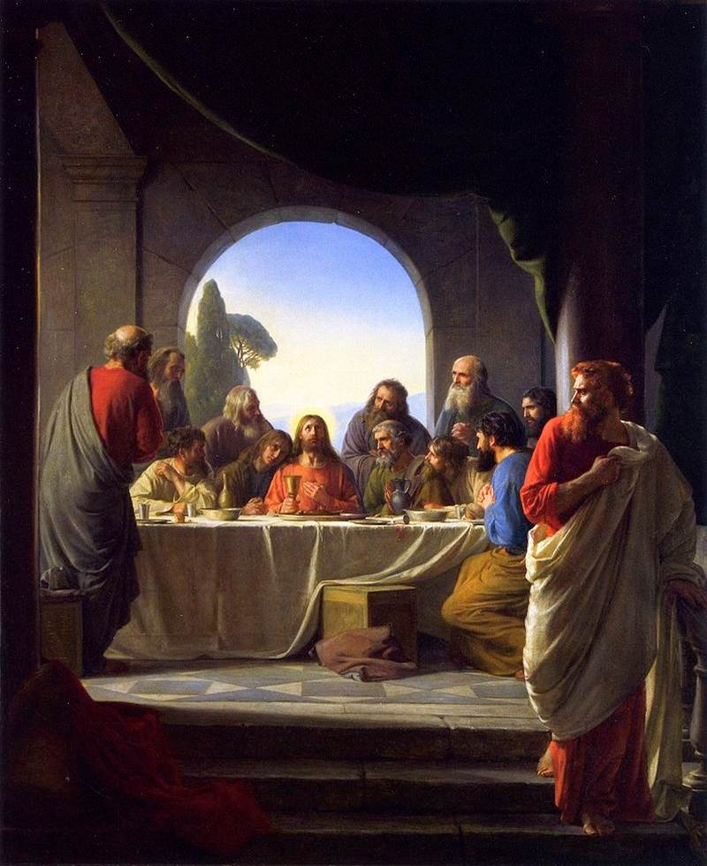
The Last Supper
Notes:
The Last Supper

Slide 30
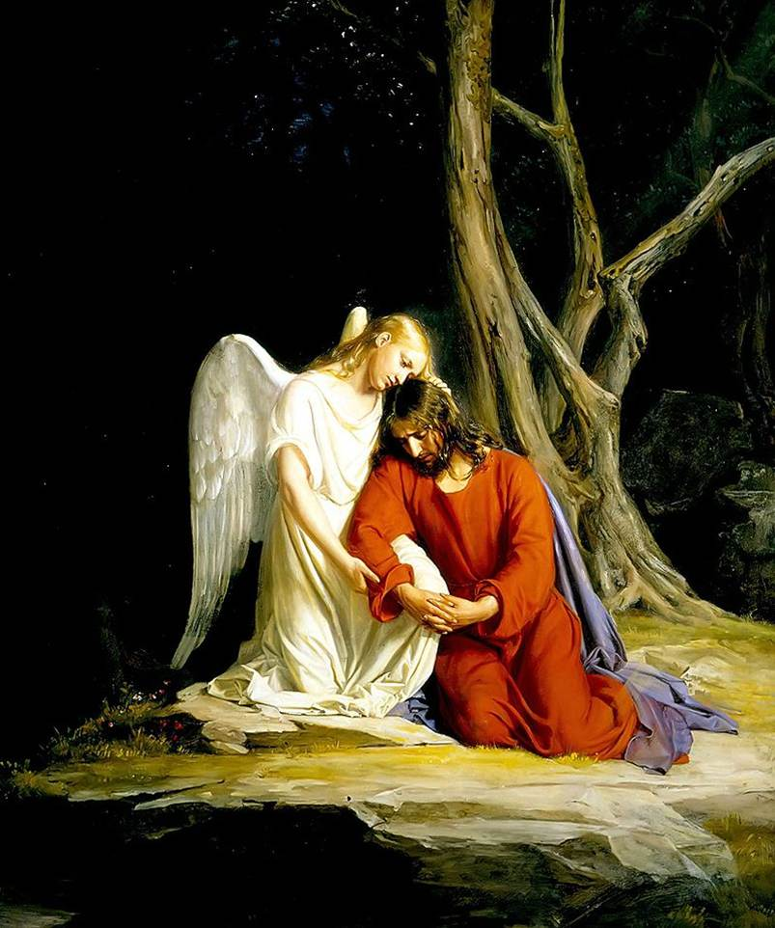
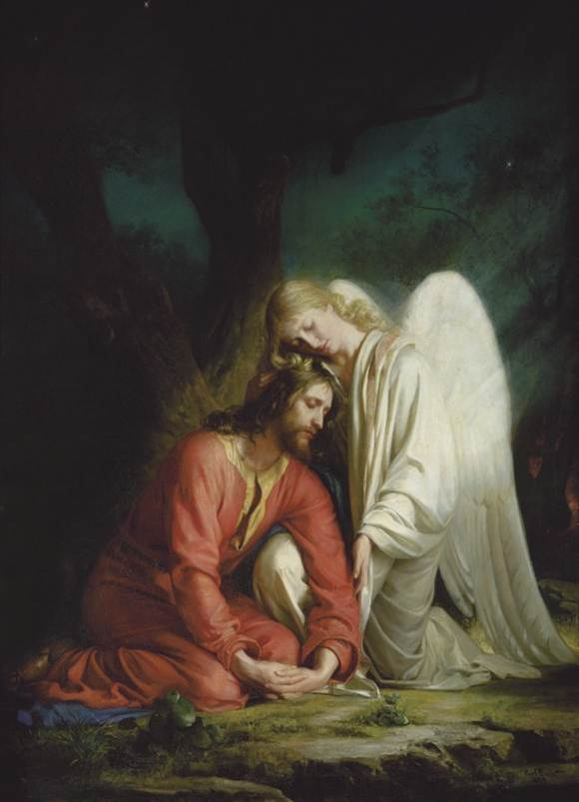
Christ in Garden Gethsemane
Notes:
Christ in Garden Gethsemane

Slide 31
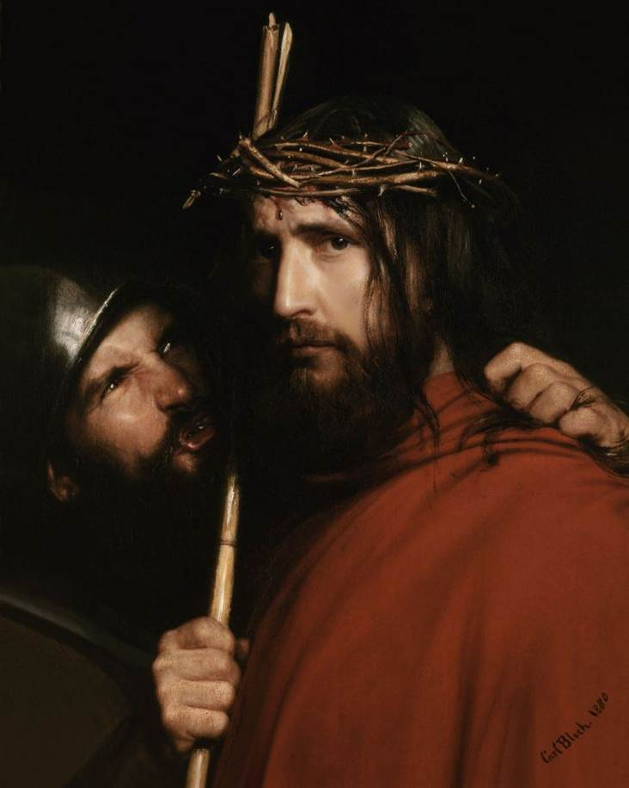
Christ with Mocking Soldier
Notes:
Christ with Mocking Soldier

Slide 32
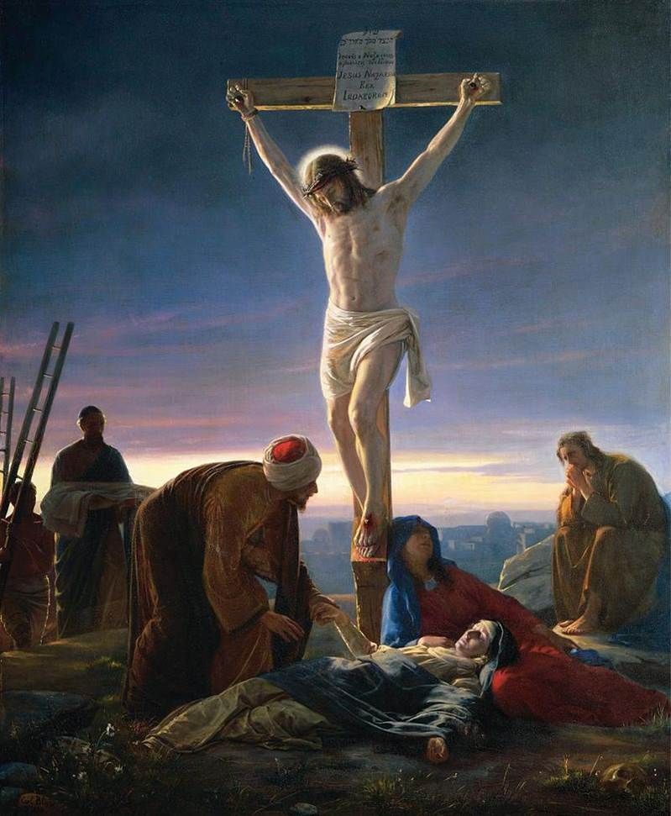
Christ at the Cross
Notes:
Christ at the Cross

Slide 33
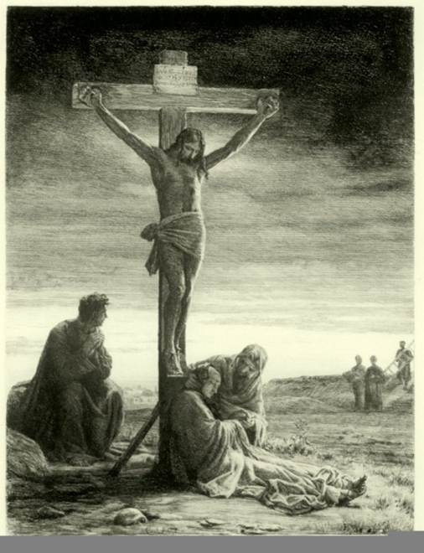
Crucifixion
of Christ
Notes:
Crucifixion of Christ

Slide 34
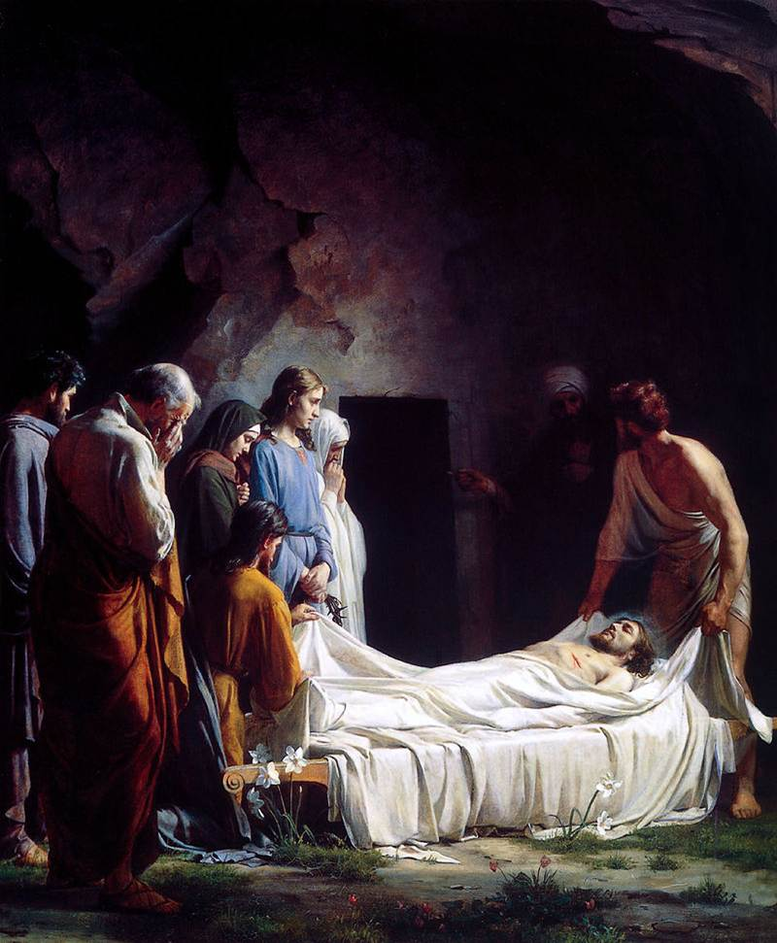
Burial of Christ
Notes:
Burial of Christ

Slide 35
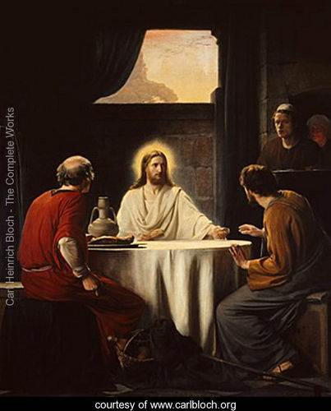
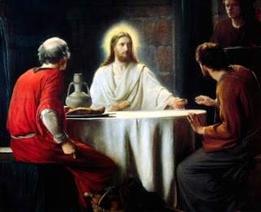
The Road to Emmaus
Notes:
The Road to Emmaus

Slide 36
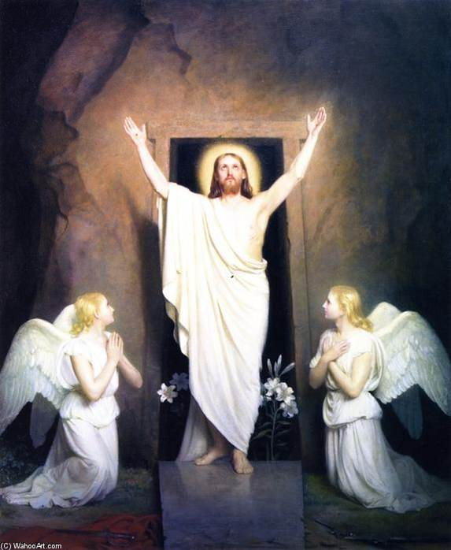
The Resurrection
of Christ
END
Notes:
The Resurrection of Christ

